Slide 1
Creating Views
Notes:
Schedule: Timing Topic
20 minutes Lecture
20 minutes Practice
40 minutes Total

Slide 2
Objectives
After completing this lesson, you should be able
to do the following:
Describe a view
Create, alter the definition of, and drop a view
Retrieve data through a view
Insert, update, and delete data through
a view
Create and use an inline view
Perform “Top-N” analysis
Notes:
Lesson Aim
In this lesson, you learn how to create and use views. You also learn to query the relevant data dictionary object to retrieve information about views. Finally, you learn to create and use inline views, and perform Top-N analysis using inline views.

Slide 3
Database Objects
Object
Table
View
Sequence
Index
Synonym
Description
Basic unit of storage; composed of rows
and columns
Logically represents subsets of data from
one or more tables
Generates primary key values
Improves the performance of some queries
Alternative name for an object

Slide 4
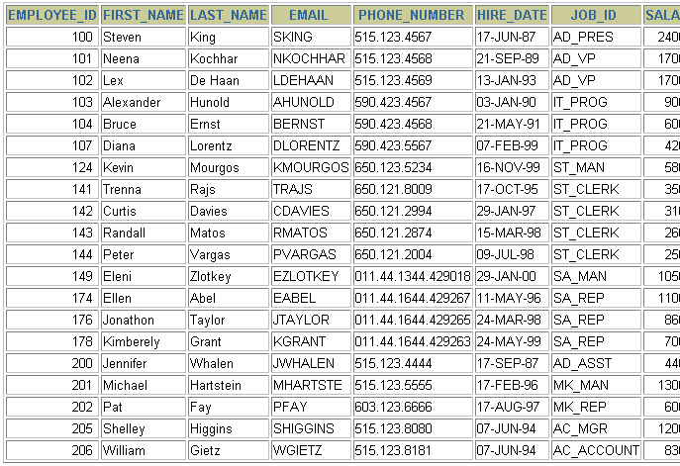

What is a View?
EMPLOYEES Table:
Notes:
What Is a View?
You can present logical subsets or combinations of data by creating views of tables. A view is a logical table based on a table or another view. A view contains no data of its own but is like a window through which data from tables can be viewed or changed. The tables on which a view is based are called base tables. The view is stored as a SELECT statement in the data dictionary.
Instructor Note
Demo: 11_easyvu.sql
Purpose: The view shown on the slide is created as follows:
CREATE OR REPLACE VIEW simple_vu
AS SELECT employee_id, last_name, salary
FROM employees;

Slide 5
Why Use Views?
To restrict data access
To make complex queries easy
To provide data independence
To present different views of the same data
Notes:
Advantages of Views
Views restrict access to the data because the view can display selective columns from the table.
Views can be used to make simple queries to retrieve the results of complicated queries. For example, views can be used to query information from multiple tables without the user knowing how to write a join statement.
Views provide data independence for ad hoc users and application programs. One view can be used to retrieve data from several tables.
Views provide groups of users access to data according to their particular criteria.
For more information, see Oracle9i SQL Reference, “CREATE VIEW.”

Slide 6
Simple Views and Complex Views
Feature Simple Views Complex Views
Number of tables One One or more
Contain functions No Yes
Contain groups of data No Yes
DML operations
through a view Yes Not always
Notes:
Simple Views versus Complex Views
There are two classifications for views: simple and complex. The basic difference is related to the DML (INSERT, UPDATE, and DELETE) operations.
A simple view is one that:
Derives data from only one table
Contains no functions or groups of data
Can perform DML operations through the view
A complex view is one that:
Derives data from many tables
Contains functions or groups of data
Does not always allow DML operations through the view

Slide 7
Creating a View
You embed a subquery within the CREATE VIEW statement.
The subquery can contain complex SELECT syntax.
CREATE [OR REPLACE] [FORCE|NOFORCE] VIEW view
[(alias[, alias]...)]
AS subquery
[WITH CHECK OPTION [CONSTRAINT constraint]]
[WITH READ ONLY [CONSTRAINT constraint]];
Notes:
Creating a View
You can create a view by embedding a subquery within the CREATE VIEW statement.
In the syntax:
OR REPLACE re-creates the view if it already exists
FORCE creates the view regardless of whether or not the base tables exist
NOFORCE creates the view only if the base tables exist (This is the default.)
view is the name of the view
alias specifies names for the expressions selected by the view’s query (The number of aliases must match the number of expressions selected by the view.)
subquery is a complete SELECT statement (You can use aliases for the columns in the SELECT list.)
WITH CHECK OPTION specifies that only rows accessible to the view can be inserted or updated
constraint is the name assigned to the CHECK OPTION constraint
WITH READ ONLY ensures that no DML operations can be performed on this view

Slide 8
Creating a View
Create a view, EMPVU80, that contains details of employees in department 80.
Describe the structure of the view by using the iSQL*Plus DESCRIBE command.
CREATE VIEW empvu80
AS SELECT employee_id, last_name, salary
FROM employees
WHERE department_id = 80;
View created.
DESCRIBE empvu80
Notes:
Creating a View (continued)
The example on the slide creates a view that contains the employee number, last name, and salary for each employee in department 80.
You can display the structure of the view by using the iSQL*Plus DESCRIBE command.
Guidelines for creating a view:
The subquery that defines a view can contain complex SELECT syntax, including joins, groups, and subqueries.
The subquery that defines the view cannot contain an ORDER BY clause. The ORDER BY clause is specified when you retrieve data from the view.
If you do not specify a constraint name for a view created with the WITH CHECK OPTION, the system assigns a default name in the format SYS_Cn.
You can use the OR REPLACE option to change the definition of the view without dropping and re-creating it or regranting object privileges previously granted on it.

Slide 9
Creating a View
Create a view by using column aliases in the subquery.
Select the columns from this view by the given alias names.
CREATE VIEW salvu50
AS SELECT employee_id ID_NUMBER, last_name NAME,
salary*12 ANN_SALARY
FROM employees
WHERE department_id = 50;
View created.
Notes:
Creating a View (continued)
You can control the column names by including column aliases within the subquery.
The example on the slide creates a view containing the employee number (EMPLOYEE_ID) with the alias ID_NUMBER, name (LAST_NAME) with the alias NAME, and annual salary (SALARY) with the alias ANN_SALARY for every employee in department 50.
As an alternative, you can use an alias after the CREATE statement and prior to the SELECT subquery. The number of aliases listed must match the number of expressions selected in the subquery.
CREATE VIEW salvu50 (ID_NUMBER, NAME, ANN_SALARY)
AS SELECT employee_id, last_name, salary*12
FROM employees
WHERE department_id = 50;
View created.
Instructor Note
Let students know about materialized views or snapshots. The terms snapshot and materialized view are synonymous. Both refer to a table that contains the results of a query of one or more tables, each of which may be located on the same or on a remote database. The tables in the query are called master tables or detail tables. The databases containing the master tables are called the master databases. For more information regarding materialized views refer to: Oracle9i SQL Reference, “CREATE MATERIALIZED VIEW / SNAPSHOT.”

Slide 10
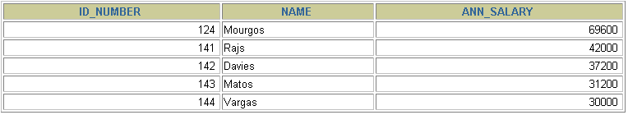
Retrieving Data from a View
SELECT *
FROM salvu50;
Notes:
Retrieving Data from a View
You can retrieve data from a view as you would from any table. You can display either the contents of the entire view or just specific rows and columns.

Slide 11

Querying a View
Oracle Server
iSQL*Plus
SELECT *
FROM empvu80;
USER_VIEWS
EMPVU80
SELECT employee_id,
last_name, salary
FROM employees
WHERE department_id=80;
EMPLOYEES
Notes:
Views in the Data Dictionary
Once your view has been created, you can query the data dictionary view called USER_VIEWS to see the name of the view and the view definition. The text of the SELECT statement that constitutes your view is stored in a LONG column.
Data Access Using Views
When you access data using a view, the Oracle server performs the following operations:
1. It retrieves the view definition from the data dictionary table USER_VIEWS.
2. It checks access privileges for the view base table.
3. It converts the view query into an equivalent operation on the underlying base table or tables. In other words, data is retrieved from, or an update is made to, the base tables.
Instructor Note
The view text is stored in a column of LONG data type. You may need to set ARRAYSIZE to a smaller value or increase the value of LONG to view the text.
Views in the Data Dictionary

Slide 12
Modifying a View
Modify the EMPVU80 view by using CREATE OR REPLACE VIEW clause. Add an alias for each column name.
Column aliases in the CREATE VIEW clause are listed in the same order as the columns in the subquery.
CREATE OR REPLACE VIEW empvu80
(id_number, name, sal, department_id)
AS SELECT employee_id, first_name || ' ' || last_name,
salary, department_id
FROM employees
WHERE department_id = 80;
View created.
Notes:
Modifying a View
With the OR REPLACE option, a view can be created even if one exists with this name already, thus replacing the old version of the view for its owner. This means that the view can be altered without dropping, re-creating, and regranting object privileges.
Note: When assigning column aliases in the CREATE VIEW clause, remember that the aliases are listed in the same order as the columns in the subquery.
Instructor Note
The OR REPLACE option started with Oracle7. With earlier versions of Oracle, if the view needed to be changed, it had to be dropped and re-created.
Demo: 11_emp.sql
Purpose: To illustrate creating a view using aliases

Slide 13
Creating a Complex View
Create a complex view that contains group functions to display values from two tables.
CREATE VIEW dept_sum_vu
(name, minsal, maxsal, avgsal)
AS SELECT d.department_name, MIN(e.salary),
MAX(e.salary),AVG(e.salary)
FROM employees e, departments d
WHERE e.department_id = d.department_id
GROUP BY d.department_name;
View created.
Notes:
Creating a Complex View
The example on the slide creates a complex view of department names, minimum salaries, maximum salaries, and average salaries by department. Note that alternative names have been specified for the view. This is a requirement if any column of the view is derived from a function or an expression.
You can view the structure of the view by using the iSQL*Plus DESCRIBE command. Display the contents of the view by issuing a SELECT statement.
SELECT *
FROM dept_sum_vu;

Slide 14
Rules for Performing
DML Operations on a View
You can perform DML operations on simple views.
You cannot remove a row if the view contains the following:
  Group functions
  A GROUP BY clause
  The DISTINCT keyword
  The pseudocolumn ROWNUM keyword
Notes:
Performing DML Operations on a View
You can perform DML operations on data through a view if those operations follow certain rules.
You can remove a row from a view unless it contains any of the following:
Group functions
A GROUP BY clause
The DISTINCT keyword
The pseudocolumn ROWNUM keyword
Instructor Note
For each row returned by a query, the ROWNUM pseudocolumn returns a number indicating the order in which Oracle server selects the row from a table or set of joined rows. The first row selected has a ROWNUM of 1, the second has 2, and so on.

Slide 15
Rules for Performing
DML Operations on a View
You cannot modify data in a view if it contains:
Group functions
A GROUP BY clause
The DISTINCT keyword
The pseudocolumn ROWNUM keyword
Columns defined by expressions
Notes:
Performing DML Operations on a View (continued)
You can modify data through a view unless it contains any of the conditions mentioned in the previous slide or columns defined by expressions—for example, SALARY * 12.

Slide 16
Rules for Performing
DML Operations on a View
You cannot add data through a view if the view
includes:
Group functions
A GROUP BY clause
The DISTINCT keyword
The pseudocolumn ROWNUM keyword
Columns defined by expressions
NOT NULL columns in the base tables that are not selected by the view
Notes:
Performing DML Operations on a View (continued)
You can add data through a view unless it contains any of the items listed in the slide or there are NOT NULL columns without default values in the base table that are not selected by the view. All required values must be present in the view. Remember that you are adding values directly into the underlying table through the view.
For more information, see 0racle9i SQL Reference, “CREATE VIEW.”
Instructor Note
With Oracle7.3 and later, you can modify views that involve joins with some restrictions. The restrictions for DML operations described in the slide also apply to join views. Any UPDATE, INSERT, or DELETE statement on a join view can modify only one underlying base table. If at least one column in the subquery join has a unique index, then it may be possible to modify one base table in a join view. You can query USER_UPDATABLE_COLUMNS to see whether the columns in a join view can be updated.

Slide 17
Using the WITH CHECK OPTION Clause
You can ensure that DML operations performed on the view stay within the domain of the view by using the WITH CHECK OPTION clause.
Any attempt to change the department number for any row in the view fails because it violates the WITH CHECK OPTION constraint.
CREATE OR REPLACE VIEW empvu20
AS SELECT *
FROM employees
WHERE department_id = 20
WITH CHECK OPTION CONSTRAINT empvu20_ck ;
View created.
Notes:
Using the WITH CHECK OPTION Clause
It is possible to perform referential integrity checks through views. You can also enforce constraints at the database level. The view can be used to protect data integrity, but the use is very limited.
The WITH CHECK OPTION clause specifies that INSERTs and UPDATEs performed through the view cannot create rows which the view cannot select, and therefore it allows integrity constraints and data validation checks to be enforced on data being inserted or updated.
If there is an attempt to perform DML operations on rows that the view has not selected, an error is displayed, with the constraint name if that has been specified.
UPDATE empvu20
SET department_id = 10
WHERE employee_id = 201;
UPDATE empvu20
*
ERROR at line 1:
ORA-01402: view WITH CHECK OPTION where-clause violation
Note: No rows are updated because if the department number were to change to 10, the view would no longer be able to see that employee. Therefore, with the WITH CHECK OPTION clause, the view can see only employees in department 20 and does not allow the department number for those employees to be changed through the view.

Slide 18
Denying DML Operations
You can ensure that no DML operations occur by adding the WITH READ ONLY option to your view definition.
Any attempt to perform a DML on any row in the view results in an Oracle server error.
Notes:
Denying DML Operations
You can ensure that no DML operations occur on your view by creating it with the WITH READ ONLY option. The example on the slide modifies the EMPVU10 view to prevent any DML operations on the view.
Instructor Note (for pages 11-17)
If the user does not supply a constraint name, the system assigns a name in the form SYS_Cn, where n is an integer that makes the constraint name unique within the system.

Slide 19
Denying DML Operations
CREATE OR REPLACE VIEW empvu10
(employee_number, employee_name, job_title)
AS SELECT employee_id, last_name, job_id
FROM employees
WHERE department_id = 10
WITH READ ONLY;
View created.
Notes:
Denying DML Operations
Any attempts to remove a row from a view with a read-only constraint results in an error.
DELETE FROM empvu10
WHERE employee_number = 200;
DELETE FROM empvu10
*
ERROR at line 1:
ORA-01752: cannot delete from view without exactly one key-
preserved table
Any attempt to insert a row or modify a row using the view with a read-only constraint results in Oracle server error:
01733: virtual column not allowed here.

Slide 20
Removing a View
You can remove a view without losing data because a view is based on underlying tables in the database.
DROP VIEW view;
DROP VIEW empvu80;
View dropped.
Notes:
Removing a View
You use the DROP VIEW statement to remove a view. The statement removes the view definition from the database. Dropping views has no effect on the tables on which the view was based. Views or other applications based on deleted views become invalid. Only the creator or a user with the DROP ANY VIEW privilege can remove a view.
In the syntax:
view is the name of the view

Slide 21
Inline Views
An inline view is a subquery with an alias (or correlation name) that you can use within a SQL statement.
A named subquery in the FROM clause of the main query is an example of an inline view.
An inline view is not a schema object.
Notes:
Inline Views
An inline view is created by placing a subquery in the FROM clause and giving that subquery an alias. The subquery defines a data source that can be referenced in the main query. In the following example, the inline view b returns the details of all department numbers and the maximum salary for each department from the EMPLOYEES table. The WHERE a.department_id = b.department_id AND a.salary < b.maxsal clause of the main query displays employee names, salaries, department numbers, and maximum salaries for all the employees who earn less than the maximum salary in their department.
SELECT a.last_name, a.salary, a.department_id, b.maxsal
FROM employees a, (SELECT department_id, max(salary) maxsal
FROM employees
GROUP BY department_id) b
WHERE a.department_id = b.department_id
AND a.salary < b.maxsal;
…

Slide 22
Top-N Analysis
Top-N queries ask for the n largest or smallest values of a column. For example:
  What are the ten best selling products?
  What are the ten worst selling products?
Both largest values and smallest values sets are considered Top-N queries.
Notes:
“Top-N” Analysis
Top-N queries are useful in scenarios where the need is to display only the n top-most or the n bottom-most records from a table based on a condition. This result set can be used for further analysis. For example, using Top-N analysis you can perform the following types of queries:
The top three earners in the company
The four most recent recruits in the company
The top two sales representatives who have sold the maximum number of products
The top three products that have had the maximum sales in the last six months
Instructor Note
The capability to include the ORDER BY clause in a subquery makes Top-N analysis possible.

Slide 23
Performing Top-N Analysis
The high-level structure of a Top-N analysis
query is:
SELECT [column_list], ROWNUM
FROM (SELECT [column_list]
FROM table
ORDER BY Top-N_column)
WHERE ROWNUM <= N;
Notes:
Performing “Top-N” Analysis
Top-N queries use a consistent nested query structure with the elements described below:
A subquery or an inline view to generate the sorted list of data. The subquery or the inline view includes the ORDER BY clause to ensure that the ranking is in the desired order. For results retrieving the largest values, a DESC parameter is needed.
An outer query to limit the number of rows in the final result set. The outer query includes the following components:
The ROWNUM pseudocolumn, which assigns a sequential value starting with 1 to each of the rows returned from the subquery.
A WHERE clause, which specifies the n rows to be returned. The outer WHERE clause must use a < or <= operator.

Slide 24

Example of Top-N Analysis
To display the top three earner names and salaries from the EMPLOYEES table:
1
2
3
SELECT ROWNUM as RANK, last_name, salary
FROM (SELECT last_name,salary FROM employees
ORDER BY salary DESC)
WHERE ROWNUM <= 3;
1
2
3
Notes:
Example of “Top-N” Analysis
The example on the slide illustrates how to display the names and salaries of the top three earners from the EMPLOYEES table. The subquery returns the details of all employee names and salaries from the EMPLOYEES table, sorted in the descending order of the salaries. The WHERE ROWNUM < 3 clause of the main query ensures that only the first three records from this result set are displayed.
Here is another example of Top-N analysis that uses an inline view. The example below uses the inline view E to display the four most senior employees in the company.
SELECT ROWNUM as SENIOR,E.last_name, E.hire_date
FROM (SELECT last_name,hire_date FROM employees
ORDER BY hire_date)E
WHERE rownum <= 4;

Slide 25
Summary
In this lesson, you should have learned that a view is
derived from data in other tables or views and
provides the following advantages:
Restricts database access
Simplifies queries
Provides data independence
Provides multiple views of the same data
Can be dropped without removing the underlying data
An inline view is a subquery with an alias name.
Top-N analysis can be done using subqueries and outer queries.
Notes:
What Is a View?
A view is based on a table or another view and acts as a window through which data on tables can be viewed or changed. A view does not contain data. The definition of the view is stored in the data dictionary. You can see the definition of the view in the USER_VIEWS data dictionary table.
Advantages of Views
Restrict database access
Simplify queries
Provide data independence
Provide multiple views of the same data
Can be removed without affecting the underlying data
View Options
Can be a simple view, based on one table
Can be a complex view based on more than one table or can contain groups of functions
Can replace other views with the same name
Can contain a check constraint
Can be read-only

Slide 26
Practice 11 Overview
This practice covers the following topics:
Creating a simple view
Creating a complex view
Creating a view with a check constraint
Attempting to modify data in the view
Displaying view definitions
Removing views
Notes:
Practice 11 Overview
In this practice, you create simple and complex views and attempt to perform DML statements on the views.

Slide 27
Producing Readable Output with iSQL*Plus
Notes:
Schedule: Timing Topic
35 minutes Lecture
35 minutes Practice
70 minutes Total

Slide 28
Objectives
After completing this lesson, you should be able to
do the following:
Produce queries that require a substitution variable
Customize the iSQL*Plus environment
Produce more readable output
Create and execute script files
Notes:
Lesson Aim
In this lesson, you will learn how to include iSQL*Plus commands to produce more readable SQL output.
You can create a command file containing a WHERE clause to restrict the rows displayed. To change the condition each time the command file is run, you use substitution variables. Substitution variables can replace values in the WHERE clause, a text string, and even a column or a table name.

Slide 29
Substitution Variables
I want to query different values.
... salary = ? …
… department_id = ? …
... last_name = ? ...
User
Notes:
Substitution Variables
The examples so far have been hard-coded. In a finished application, the user would trigger the report, and the report would run without further prompting. The range of data would be predetermined by the fixed WHERE clause in the iSQL*Plus script file.
Using iSQL*Plus, you can create reports that prompt the user to supply their own values to restrict the range of data returned by using substitution variables. You can embed substitution variables in a command file or in a single SQL statement. A variable can be thought of as a container in which the values are temporarily stored. When the statement is run, the value is substituted.
Instructor Note
Demo: 7_varno.sql, 7_varyes.sql
Purpose: To illustrate returning all rows and using a case-insensitive query with substitution variables.
With iSQL*Plus 9.0.1.0.1, there is a bug when using &substitution and wildcards (%) for character values.
This bug has been reported. The 7_varyes.sql will produce an error in iSQL*Plus, but the concept is important for students continuing classes using other products (such as Forms, Reports). You may want to demonstrate 7_varyes.sql in the SQL*Plus environment as an option.

Slide 30
Substitution Variables
Use iSQL*Plus substitution variables to:
Temporarily store values
  Single ampersand (&)
  Double ampersand (&&)
  DEFINE command
Pass variable values between SQL statements
Dynamically alter headers and footers
Notes:
Substitution Variables
In iSQL*Plus, you can use single ampersand (&) substitution variables to temporarily store values.
You can predefine variables in iSQL*Plus by using the DEFINE command. DEFINE creates and assigns a value to a variable.
Examples of Restricted Ranges of Data
Reporting figures only for the current quarter or specified date range
Reporting on data relevant only to the user requesting the report
Displaying personnel only within a given department
Other Interactive Effects
Interactive effects are not restricted to direct user interaction with the WHERE clause. The same principles can be used to achieve other goals. For example:
Dynamically altering headers and footers
Obtaining input values from a file rather than from a person
Passing values from one SQL statement to another
iSQL*Plus does not support validation checks (except for data type) on user input.
Instructor Note
A substitution variable can be used anywhere in SQL and iSQL*Plus commands, except as the first word entered at the command prompt.

Slide 31
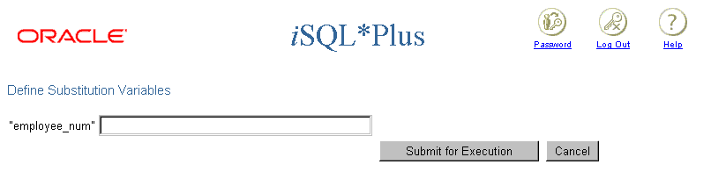
Using the & Substitution Variable
Use a variable prefixed with an ampersand (&) to prompt the user for a value.
SELECT employee_id, last_name, salary, department_id
FROM employees
WHERE employee_id = &employee_num ;
Notes:
Single-Ampersand Substitution Variable
When running a report, users often want to restrict the data returned dynamically. iSQL*Plus provides this flexibility by means of user variables. Use an ampersand (&) to identify each variable in your SQL statement. You do not need to define the value of each variable.
The example on the slide creates an iSQL*Plus substitution variable for an employee number. When the statement is executed, iSQL*Plus prompts the user for an employee number and then displays the employee number, last name, salary, and department number for that employee.
With the single ampersand, the user is prompted every time the command is executed, if the variable does not exist.

Slide 32
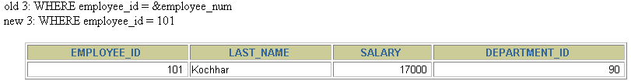
Using the & Substitution Variable
2
101
1
Notes:
Single-Ampersand Substitution Variable
When iSQL*Plus detects that the SQL statement contains an &, you are prompted to enter a value for the substitution variable named in the SQL statement. Once you enter a value and click the Submit for Execution button, the results are displayed in the output area of your iSQL*Plus session.

Slide 33
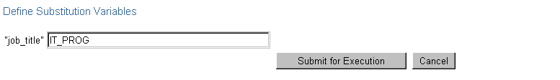
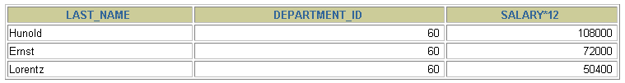
Character and Date Values with Substitution Variables
Use single quotation marks for date and character
values.
SELECT last_name, department_id, salary*12
FROM employees
WHERE job_id = '&job_title' ;
Notes:
Specifying Character and Date Values with Substitution Variables
In a WHERE clause, date and character values must be enclosed within single quotation marks. The same rule applies to the substitution variables.
Enclose the variable in single quotation marks within the SQL statement itself.
The slide shows a query to retrieve the employee names, department numbers, and annual salaries of all employees based on the job title value of the iSQL*Plus substitution variable.
Note: You can also use functions such as UPPER and LOWER with the ampersand. Use UPPER('&job_title') so that the user does not have to enter the job title in uppercase.

Slide 34
Specifying Column Names,
Expressions, and Text
Use substitution variables to supplement the
following:
WHERE conditions
ORDER BY clauses
Column expressions
Table names
Entire SELECT statements
Notes:
Specifying Column Names, Expressions, and Text
Not only can you use the substitution variables in the WHERE clause of a SQL statement, but these variables can also be used to substitute for column names, expressions, or text.
Example
Display the employee number and any other column and any condition of employees.
SELECT employee_id, &column_name
FROM employees
WHERE &condition;
If you do not enter a value for the substitution variable, you will get an error when you execute the preceding statement.
Note: A substitution variable can be used anywhere in the SELECT statement, except as the first word entered at the command prompt.

Slide 35
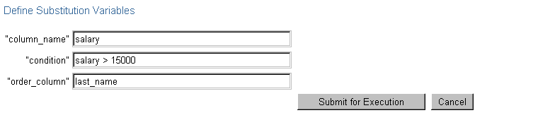
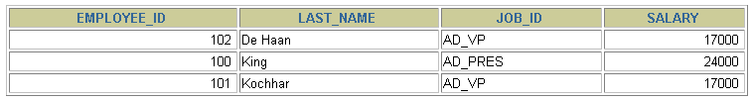
Specifying Column Names,
Expressions, and Text
SELECT employee_id, last_name, job_id,
&column_name
FROM employees
WHERE &condition
ORDER BY &order_column ;
Notes:
Specifying Column Names, Expressions, and Text (continued)
The slide example displays the employee number, name, job title, and any other column specified by the user at run time, from the EMPLOYEES table. You can also specify the condition for retrieval of rows and the column name by which the resultant data has to be ordered.
Instructor Note
Demo: 7_expr.sql
Purpose: To illustrate changing column names and conditions by using substitution variables

Slide 36
Defining Substitution Variables
You can predefine variables using the iSQL*Plus DEFINE command.
  DEFINE variable = value creates a user variable with the CHAR data type.
If you need to predefine a variable that includes spaces, you must enclose the value within single quotation marks when using the DEFINE command.
A defined variable is available for the session
Notes:
Defining Substitution Variables
You can predefine user variables before executing a SELECT statement. iSQL*Plus provides the DEFINE command for defining and setting substitution variables:
Instructor Note
Mention that iSQL*Plus commands can continue onto multiple lines and that they require the continuation character, the hyphen.

Slide 37
DEFINE and UNDEFINE Commands
A variable remains defined until you either:
  Use the UNDEFINE command to clear it
  Exit iSQL*Plus
You can verify your changes with the DEFINE command.
DEFINE job_title = IT_PROG
DEFINE job_title
DEFINE JOB_TITLE = "IT_PROG" (CHAR)
UNDEFINE job_title
DEFINE job_title
SP2-0135: symbol job_title is UNDEFINED
Notes:
The DEFINE and UNDEFINE Commands
Variables are defined until you either:
Issue the UNDEFINE command on a variable
Exit iSQL*Plus
When you undefine variables, you can verify your changes with the DEFINE command. When you exit iSQL*Plus, variables defined during that session are lost.

Slide 38
Using the DEFINE Command with
& Substitution Variable
Create the substitution variable using the DEFINE command.
Use a variable prefixed with an ampersand (&) to substitute the value in the SQL statement.
DEFINE employee_num = 200
SELECT employee_id, last_name, salary, department_id
FROM employees
WHERE employee_id = &employee_num ;
Notes:
Using the DEFINE Command
The example on the slide creates an iSQL*Plus substitution variable for an employee number by using the DEFINE command, and at run time displays the employee number, name, salary, and department number for that employee.
Because the variable is created using the iSQL*Plus DEFINE command, the user is not prompted to enter a value for the employee number. Instead, the defined variable value is automatically substituted in the SELECT statement.
The EMPLOYEE_NUM substitution variable is present in the session until the user undefines it or exits the iSQL*Plus session.

Slide 39
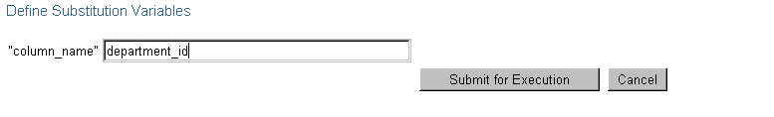
Using the && Substitution Variable
Use the double-ampersand (&&) if you want to reuse
the variable value without prompting the user each
time.
SELECT employee_id, last_name, job_id, &&column_name
FROM employees
ORDER BY &column_name;
…
Notes:
Double-Ampersand Substitution Variable
You can use the double-ampersand (&&) substitution variable if you want to reuse the variable value without prompting the user each time. The user will see the prompt for the value only once. In the example on the slide, the user is asked to give the value for variable column_name only once. The value supplied by the user (department_id) is used both for display and ordering of data.
iSQL*Plus stores the value supplied by using the DEFINE command; it will use it again whenever you reference the variable name. Once a user variable is in place, you need to use the UNDEFINE command to delete it.

Slide 40
Using the VERIFY Command
Use the VERIFY command to toggle the display of the
substitution variable, before and after iSQL*Plus
replaces substitution variables with values.
SET VERIFY ON
SELECT employee_id, last_name, salary, department_id
FROM employees
WHERE employee_id = &employee_num;
old 3: WHERE employee_id = &employee_num
new 3: WHERE employee_id = 200
Notes:
The VERIFY Command
To confirm the changes in the SQL statement, use the iSQL*Plus VERIFY command. Setting SET VERIFY ON forces iSQL*Plus to display the text of a command before and after it replaces substitution variables with values.
The example on the slide displays the old as well as the new value of the EMPLOYEE_ID column.

Slide 41
Customizing the iSQL*Plus Environment
Use SET commands to control current session.
Verify what you have set by using the SHOW command.
SET system_variable value
SET ECHO ON
SHOW ECHO
echo ON
Notes:
Customizing the iSQL*Plus Environment
You can control the environment in which iSQL*Plus is currently operating by using the SET commands.
Syntax
SET system_variable value
In the syntax:
system_variable is a variable that controls one aspect of the session environment
value is a value for the system variable
You can verify what you have set by using the SHOW command. The SHOW command on the slide checks whether ECHO had been set on or off.
To see all SET variable values, use the SHOW ALL command.
For more information, see iSQL*Plus User’s Guide and Reference, “Command Reference.”

Slide 42
SET Command Variables
ARRAYSIZE {20 | n}
FEEDBACK {6 | n |OFF | ON}
HEADING {OFF | ON}
LONG {80 | n}| ON | text}
SET HEADING OFF
SHOW HEADING
HEADING OFF
Notes:
SET Command Variables
Note: The value n represents a numeric value. The underlined values indicate default values. If you enter no value with the variable, iSQL*Plus assumes the default value.

Slide 43
iSQL*Plus Format Commands
  COLUMN [column option]
  TTITLE [text | OFF | ON]
  BTITLE [text | OFF | ON]
  BREAK [ON report_element]
Notes:
Obtaining More Readable Reports
You can control the report features by using the following commands:
Guidelines
All format commands remain in effect until the end of the iSQL*Plus session or until the format setting is overwritten or cleared.
Remember to reset your iSQL*Plus settings to the default values after every report.
There is no command for setting an iSQL*Plus variable to its default value; you must know the specific value or log out and log in again.
If you give an alias to your column, you must reference the alias name, not the column name.

Slide 44
The COLUMN Command
Controls display of a column:
CLE[AR]: Clears any column formats
HEA[DING] text: Sets the column heading
FOR[MAT] format: Changes the display of the column using a format model
NOPRINT | PRINT
NULL
COL[UMN] [{column|alias} [option]]
Notes:
COLUMN Command Options

Slide 45
Using the COLUMN Command
Create column headings.
COLUMN last_name HEADING 'Employee|Name'
COLUMN salary JUSTIFY LEFT FORMAT $99,990.00
COLUMN manager FORMAT 999999999 NULL 'No manager'
Display the current setting for the LAST_NAME column.
COLUMN last_name
Clear settings for the LAST_NAME column.
COLUMN last_name CLEAR
Notes:
Displaying or Clearing Settings
To show or clear the current COLUMN command settings, use the following commands:

Slide 46
COLUMN Format Models
Element
9
0
$
L
.
,
Description
Single zero-suppression digit
Enforces leading zero
Floating dollar sign
Local currency
Position of decimal point
Thousand separator
Example
999999
099999
$9999
L9999
9999.99
9,999
Result
1234
001234
$1234
L1234
1234.00
1,234
Notes:
COLUMN Format Models
The slide displays sample COLUMN format models.
The Oracle server displays a string of pound signs (#) in place of a whole number whose digits exceed the number of digits provided in the format model. It also displays pound signs in place of a value whose format model is alphanumeric but whose actual value is numeric.

Slide 47
Using the BREAK Command
Use the BREAK command to suppress duplicates.
BREAK ON job_id
Notes:
The BREAK Command
Use the BREAK command to divide rows into sections and suppress duplicate values. To ensure that the BREAK command works effectively, use the ORDER BY clause to order the columns that you are breaking on.
Syntax
BREAK on column[|alias|row]
In the syntax:
column[|alias|row suppresses the display of duplicate values for a given column
Clear all BREAK settings by using the CLEAR command:
CLEAR BREAK

Slide 48
Using the TTITLE and BTITLE Commands
Display headers and footers.
Set the report header.
Set the report footer.
TTI[TLE] [text|OFF|ON]
TTITLE 'Salary|Report'
BTITLE 'Confidential'
Notes:
The TTITLE and BTITLE Commands
Use the TTITLE command to format page headers and the BTITLE command for footers. Footers appear at the bottom of the page.
The syntax for BTITLE and TTITLE is identical. Only the syntax for TTITLE is shown. You can use the vertical bar (|) to split the text of the title across several lines.
Syntax
TTI[TLE]|BTI[TLE] [text|OFF|ON]
In the syntax:
text represents the title text (enter single quotes if the text is more than one word).
OFF|ON toggles the title either off or on. It is not visible when turned off.
The TTITLE example on the slide sets the report header to display Salary centered on one line and Report centered below it. The BTITLE example sets the report footer to display Confidential. TTITLE automatically puts the date and a page number on the report.

Slide 49
Using the TTITLE and BTITLE Commands
Display headers and footers.
Set the report header.
Set the report footer.
TTI[TLE] [text|OFF|ON]
TTITLE 'Salary|Report'
BTITLE 'Confidential'
Notes:
The TTITLE and BTITLE Commands (continued)
Note: The slide gives an abridged syntax for TTITLE and BTITLE. Various options for TTITLE and BTITLE are covered in another SQL course.
Instructor Note
SQL*Plus 3.3 introduced the commands REPHEADER and REPFOOTER. REPHEADER places and formats a specified report header at the top of each report or lists the current REPHEADER definition. REPFOOTER places and formats a specified report footer at the bottom of each report or lists the current REPFOOTER definition.

Slide 50
Creating a Script File to Run a Report
  1. Create and test the SQL SELECT statement.
  2. Save the SELECT statement into a script file.
  3. Load the script file into an editor.
  4. Add formatting commands before the SELECT statement.
  5. Verify that the termination character follows the SELECT statement.
Notes:
Creating a Script File to Run a Report
You can either enter each of the iSQL*Plus commands at the SQL prompt or put all the commands, including the SELECT statement, in a command (or script) file. A typical script consists of at least one SELECT statement and several iSQL*Plus commands.
How to Create a Script File
1. Create the SQL SELECT statement at the SQL prompt. Ensure that the data required for the report is accurate before you save the statement to a file and apply formatting commands. Ensure that the relevant ORDER BY clause is included if you intend to use breaks.
2. Save the SELECT statement to a script file.
3. Edit the script file to enter the iSQL*Plus commands.
4. Add the required formatting commands before the SELECT statement. Be certain not to place iSQL*Plus commands within the SELECT statement.
5. Verify that the SELECT statement is followed by a run character, either a semicolon (;) or a slash (/).

Slide 51
Creating a Script File to Run a Report
  6. Clear formatting commands after the SELECT statement.
  7. Save the script file.
  8. Load the script file into the iSQL*Plus text window, and click the Execute button.
Notes:
How to Create a Script File (continued)
6. Add the format-clearing iSQL*Plus commands after the run character. Alternatively, you can store all the format-clearing commands in a reset file.
7. Save the script file with your changes.
8. Load the script file into the iSQL*Plus text window, and click the Execute button.
Guidelines
You can include blank lines between iSQL*Plus commands in a script.
If you have a lengthy iSQL*Plus or SQL*Plus command, you can continue it on the next line by ending the current line with a hyphen (-).
You can abbreviate iSQL*Plus commands.
Include reset commands at the end of the file to restore the original iSQL*Plus environment.
Note: REM represents a remark or comment in iSQL*Plus.

Slide 52
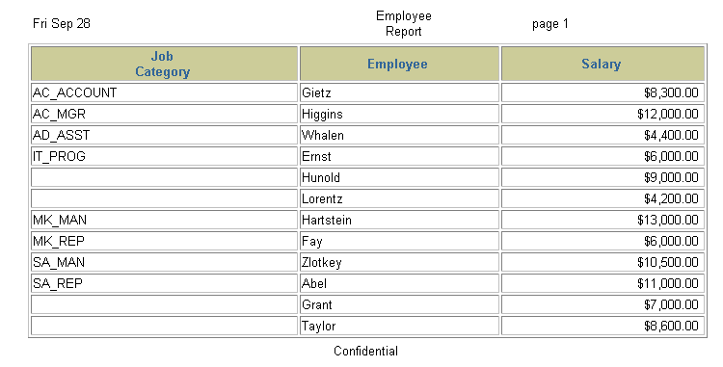
Sample Report
…
Notes:
Example
Create a script file to create a report that displays the job ID, last name, and salary for every employee whose salary is less than $15,000. Add a centered, two-line header that reads “Employee Report” and a centered footer that reads “Confidential.” Rename the job title column to read “Job Category” split over two lines. Rename the employee name column to read “Employee.” Rename the salary column to read “Salary” and format it as $2,500.00.

Slide 53
Sample Report
…
Notes:
Example (continued)
SET FEEDBACK OFF
TTITLE 'Employee|Report'
BTITLE 'Confidential'
BREAK ON job_id
COLUMN job_id HEADING 'Job|Category'
COLUMN last_name HEADING 'Employee'
COLUMN salary HEADING 'Salary' FORMAT $99,999.99
REM ** Insert SELECT statement
SELECT job_id, last_name, salary
FROM employees
WHERE salary < 15000
ORDER BY job_id, last_name
/
REM clear all formatting commands ...
SET FEEDBACK ON
COLUMN job_id CLEAR
COLUMN last_name CLEAR
COLUMN salary CLEAR
CLEAR BREAK
...

Slide 54
Summary
In this lesson, you should have learned how to:
Use iSQL*Plus substitution variables to store values temporarily
Use SET commands to control the current iSQL*Plus environment
Use the COLUMN command to control the display of a column
Use the BREAK command to suppress duplicates and divide rows into sections
Use the TTITLE and BTITLE commands to display headers and footers
Notes:
Summary
In this lesson, you should have learned about substitution variables and how useful they are for running reports. They give you the flexibility to replace values in a WHERE clause, column names, and expressions. You can customize reports by writing script files with:
Single ampersand substitution variables
Double ampersand substitution variables
The DEFINE command
The UNDEFINE command
Substitution variables in the command line
You can create a more readable report by using the following commands:
COLUMN
TTITLE
BTITLE
BREAK

Slide 55
Practice 7 Overview
This practice covers the following topics:
Creating a query to display values using substitution variables
Starting a command file containing variables
Notes:
Practice 7 Overview
This practice gives you the opportunity to create files that can be run interactively by using substitution variables to create run-time selection criteria.

